Slide 1



School Degree Management System
Presented to
Dr / Mahmoud Ali Saber
Eng / Rawan Omar
Edited by
Abdelrahman Rabie

Slide 2
Titels
01
02
03
04
problem
solution
validation
conclusion

Slide 3
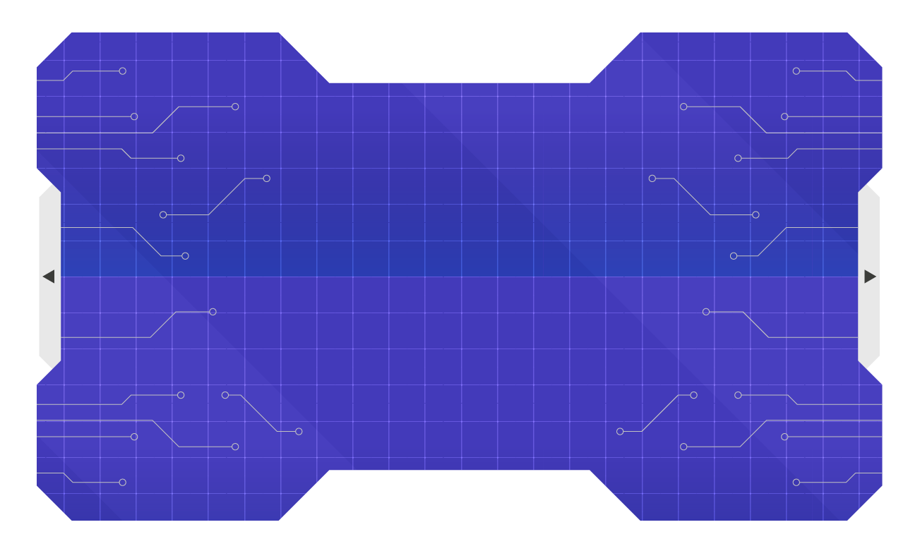
01
Problem

Slide 4

Problem
Current Challenges:
Manual result entry is time-consuming and error-prone.
Difficulty in securely storing and retrieving student results.
Limited accessibility for students and staff.
Risks of data tampering or loss.
Objective of the Program:
Simplify result management.
Ensure security and accuracy in data storage.
Provide easy access to students and staff.

Slide 5
02
Solution

Slide 6
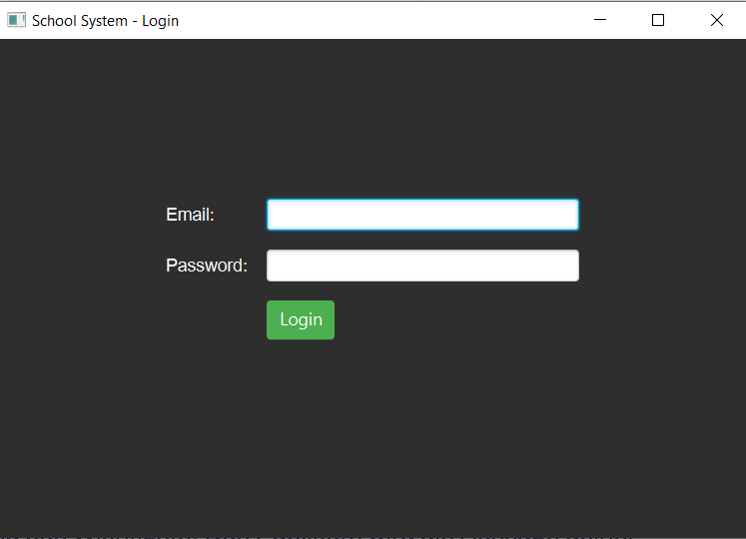
Solution
A desktop-based application built using Java and JavaFX.
Provides login functionality for students and administrators.
Offers features like result viewing, data modification, and printing reports.

Slide 7
Features
Login System:
Separate logins for students and administrators.
Authentication for secure access.
Student Dashboard:
Displays grades in Math, Science, and English.
Provides an option to print results.
Admin Dashboard:
Modify student data.
Update and save student grades securely.
Secure Data Handling:
Encrypted storage of sensitive data.
Data persistence through text files and serialized files.

Slide 8

Benefits
For Students:
Easy access to their grades.
Ability to print their results.
For Administrators:
Simplified data management.
Securely update and store student information.
For Schools:
Reduces manual work.
Minimizes errors in result handling.

Slide 9
03
Validation

Slide 10
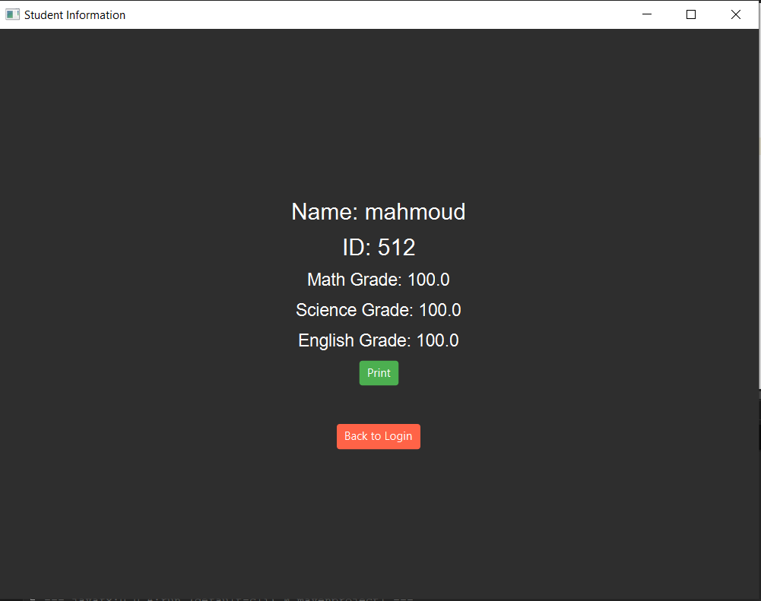
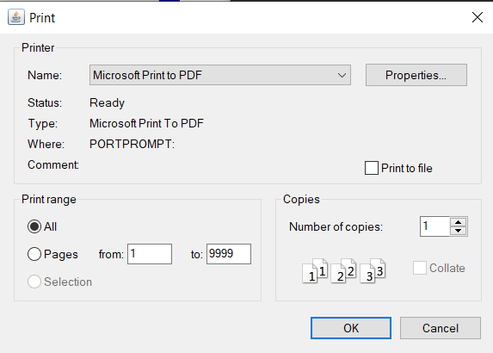
Students

Slide 11
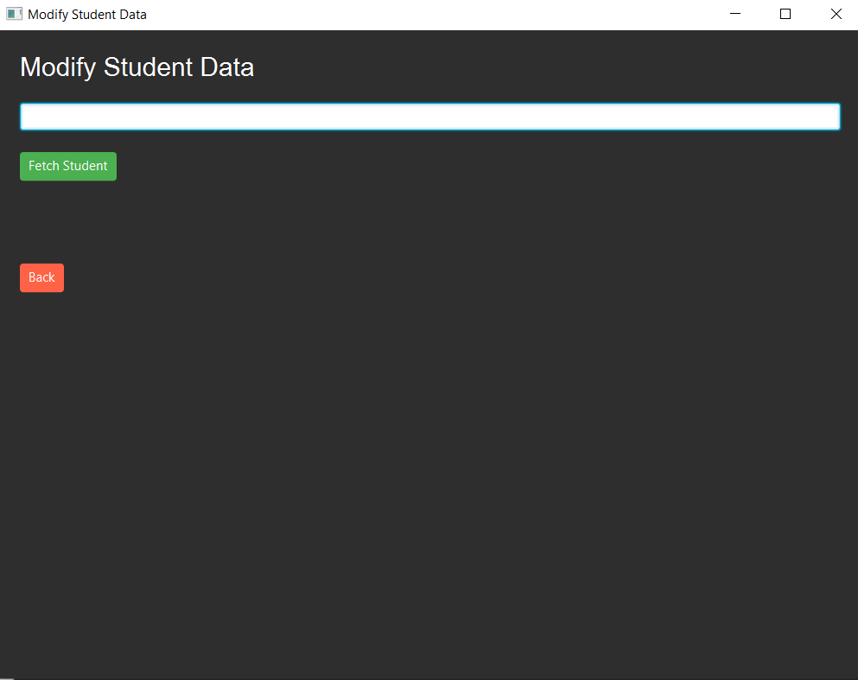
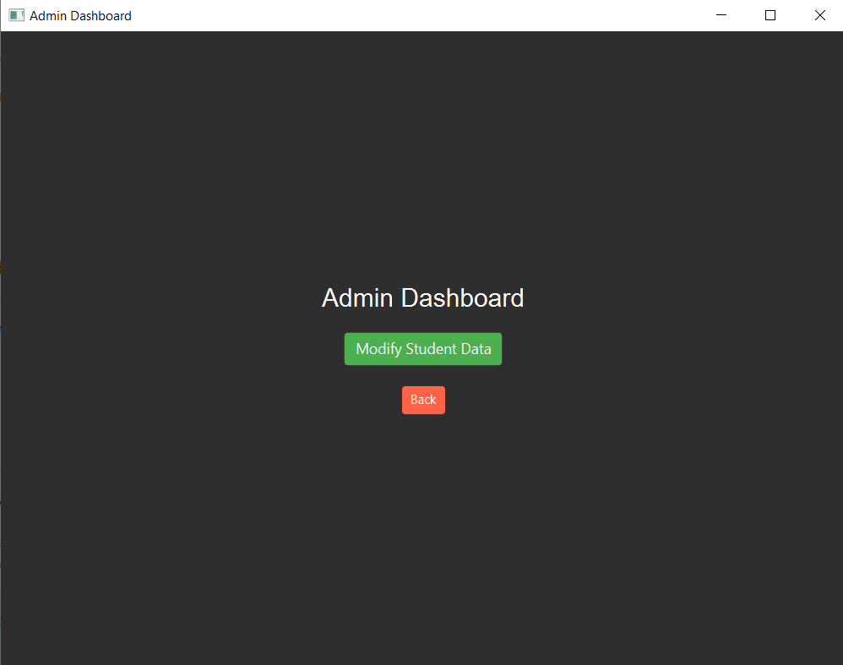
Admin

Slide 12
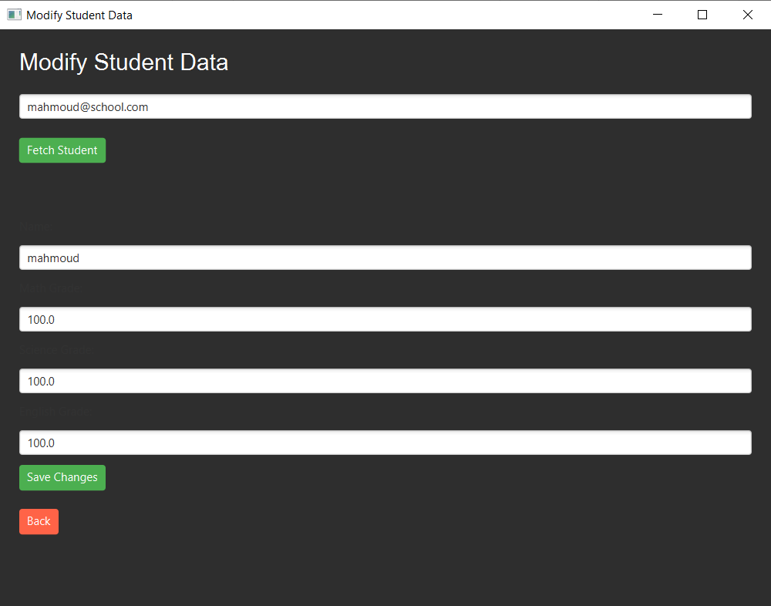
Change Data

Slide 13
04
Conclusion

Slide 14
Future Enhancements
Add cloud-based storage for remote access.
Integrate graphical performance analytics for students.
Implement a web-based version for broader accessibility.

Slide 15
References
https://www.geeksforgeeks.org/file-handling-in-java/?utm_source=chatgpt.com
https://docs.oracle.com/javase/8/docs/platform/serialization/spec/serial-arch.html
https://docs.oracle.com/javase/8/docs/technotes/guides/collections/
https://docs.oracle.com/javase/tutorial/
Introduction to Java Programming 10th Ed – 2015 denial

Slide 16


Thank You!
Any Question!

